Slide 3
Kako razvijati kvalitetne mobilne aplikacje s alatima Xamarin: UITest, Test.Cloud i Insights
Miljenko Cvjetko
Developer
Software Engineer on Xamarin Components Team
mcvjetko@holisticware.net
miljenko.cvjetko@xamarin.com
https://holisticware.net
https://xamarin.com

Slide 4


Xamarin.Process Quality
QUALITY HIGH IMPORTANCE mobile not only mobile

Slide 5
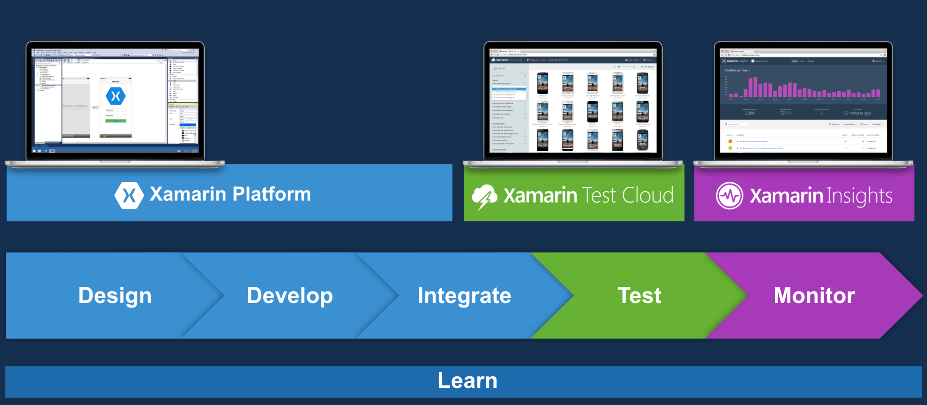
Xamarin.Process
Xamarin.Process
2014.Q3
Full / Complete App Development Process
Xamarin.Process
Features stable phase for: Design and Development Tools
Features – extensions: Testing

Slide 6
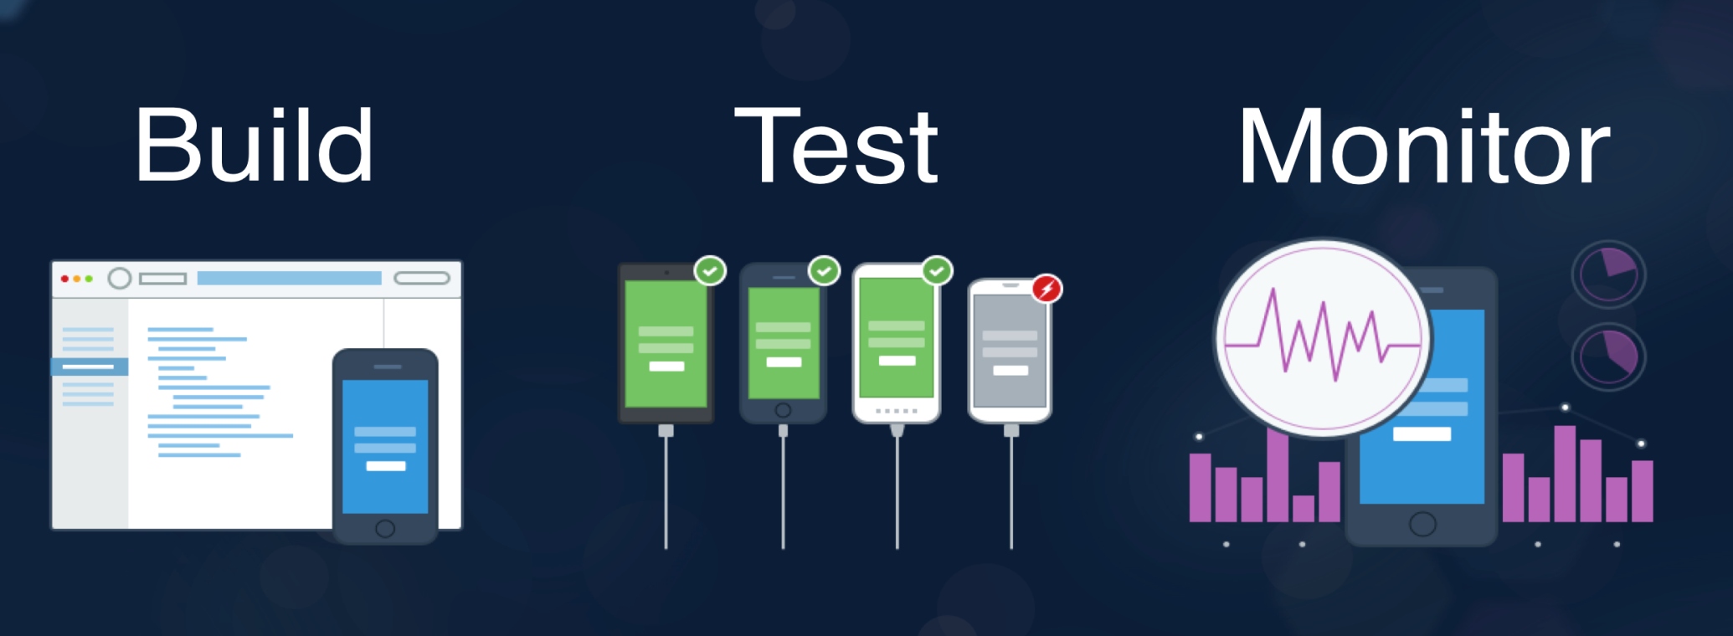
Xamarin.Process.Test
Testing part of the process
Design
Build
Integrate
Deploy
Test
Monitor
Test Tools and Services
Xamarin.UITest
Xamarin.Test.Cloud
Xamarin.Insights

Slide 7
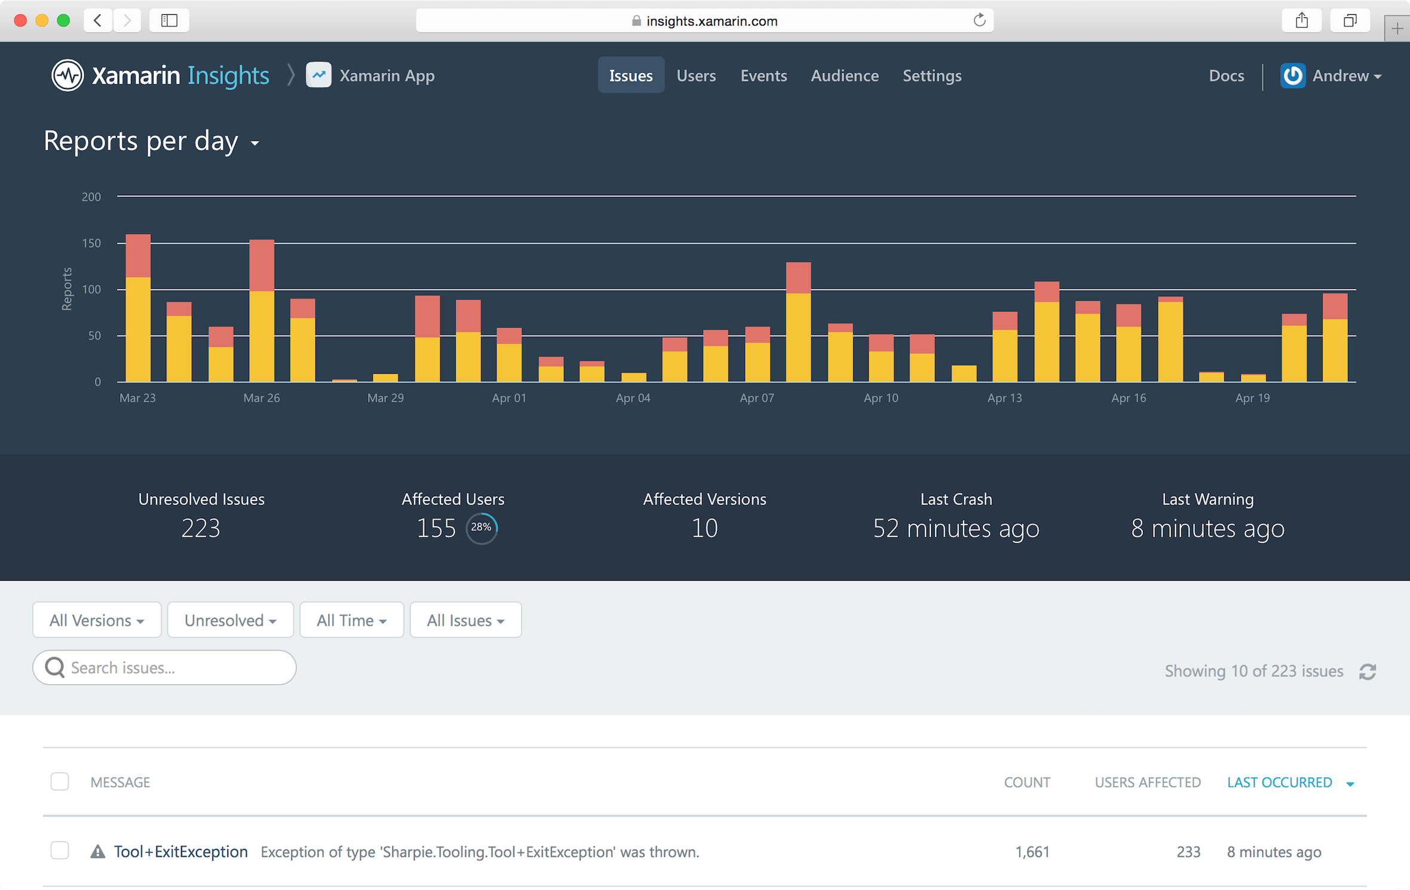
Xamarin.Process.Monitoring – Insights 01
Monitoring
Production apps (not only)
Xamarin.Insights https://xamarin.com/insights
Purpose

Slide 8
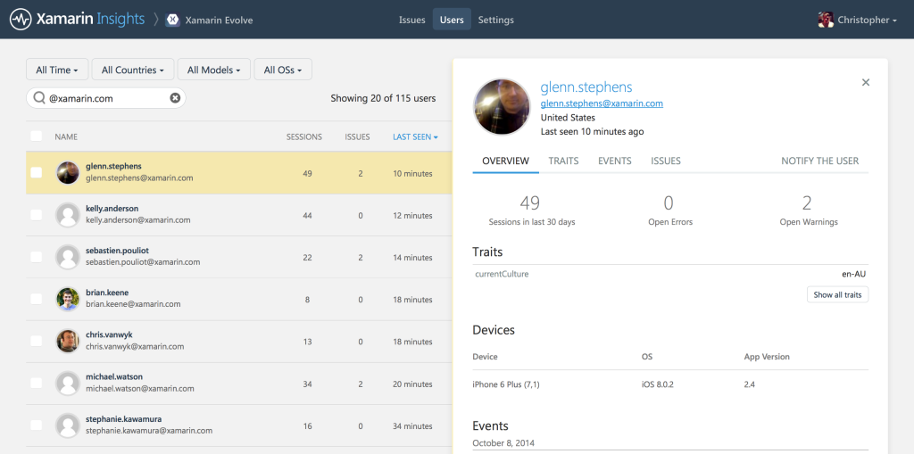
Xamarin.Process.Monitoring – Insights 02
Platforms
Mobile Xamarin.Android Xamarin.iOS Windows Phone (8, 8.1WinRT, 8.1SL?)
Desktop Windows MacOSX
ASP.net ??
Architecture
client/server
Client Xamarin.Insights – PCL
Server – Insights portal https://insights.xamarin.com/app/

Slide 9
Xamarin.Process.Monitoring – Insights 03
Process
Setup Application on the server/portal https://insights.xamarin.com/app/
Prepare apps for monitoring add nuget packages
Initialize application
Monitor

Slide 10
Xamarin.Insights Monitoring

Slide 11
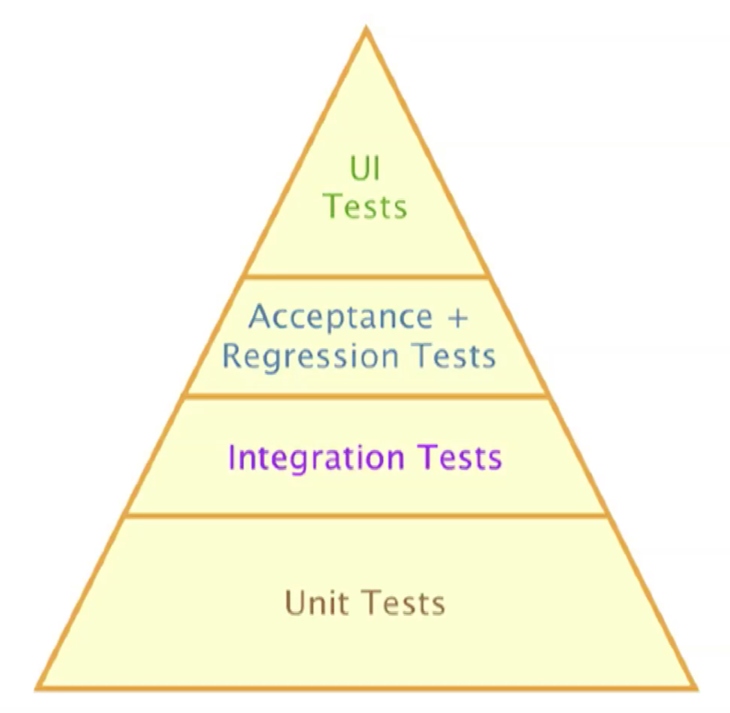
Xamarin.Process.Test – UITest 01
Test types
Unit Testing API testing (libraries) – internals .net: nunit, MSTest, xUnit
Integration Testing
Regression Testing
UI/Acceptance/Functional Testing end to end user interaction simulation
Xamarin.UITest
UI (Acceptance) Test Framework
Based on
nunit - c#
Calabash
Mobile applications Xamarin native (iOS, Android) Xamarin.Forms native Android and iOS apps Hybrid Apps

Slide 12
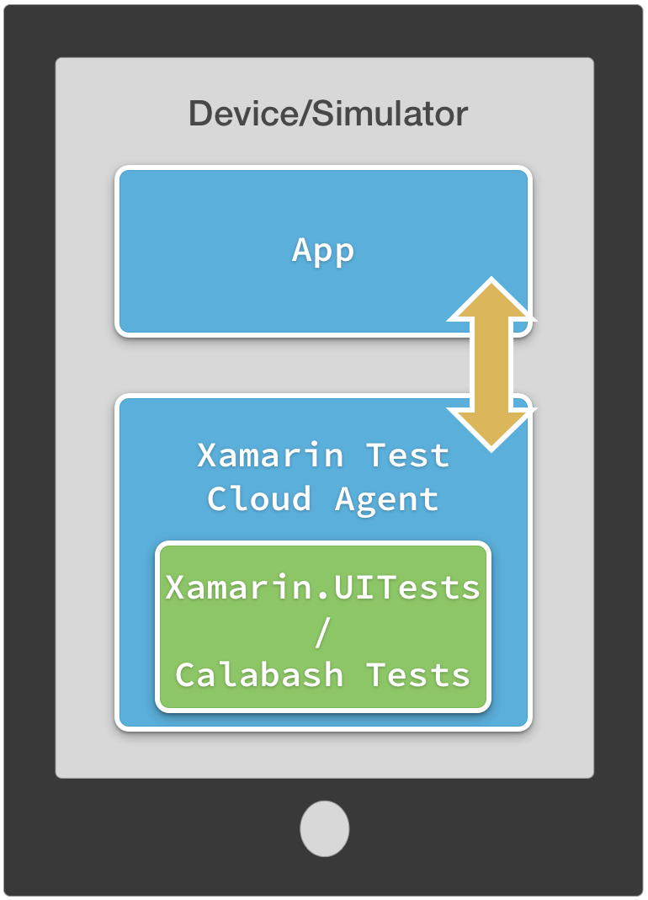
Xamarin.Process.Test – UITest 02
Architecture
General Test executed on
Device
Simulator/emulator

Slide 13
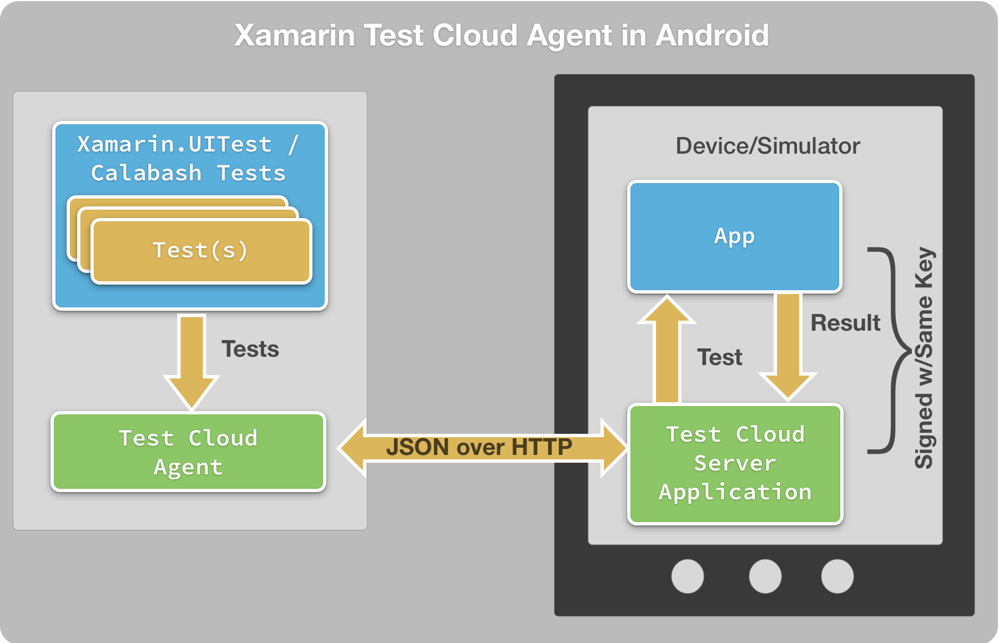
Xamarin.Process.Test – UITest 03
Architecture.Android

Slide 14
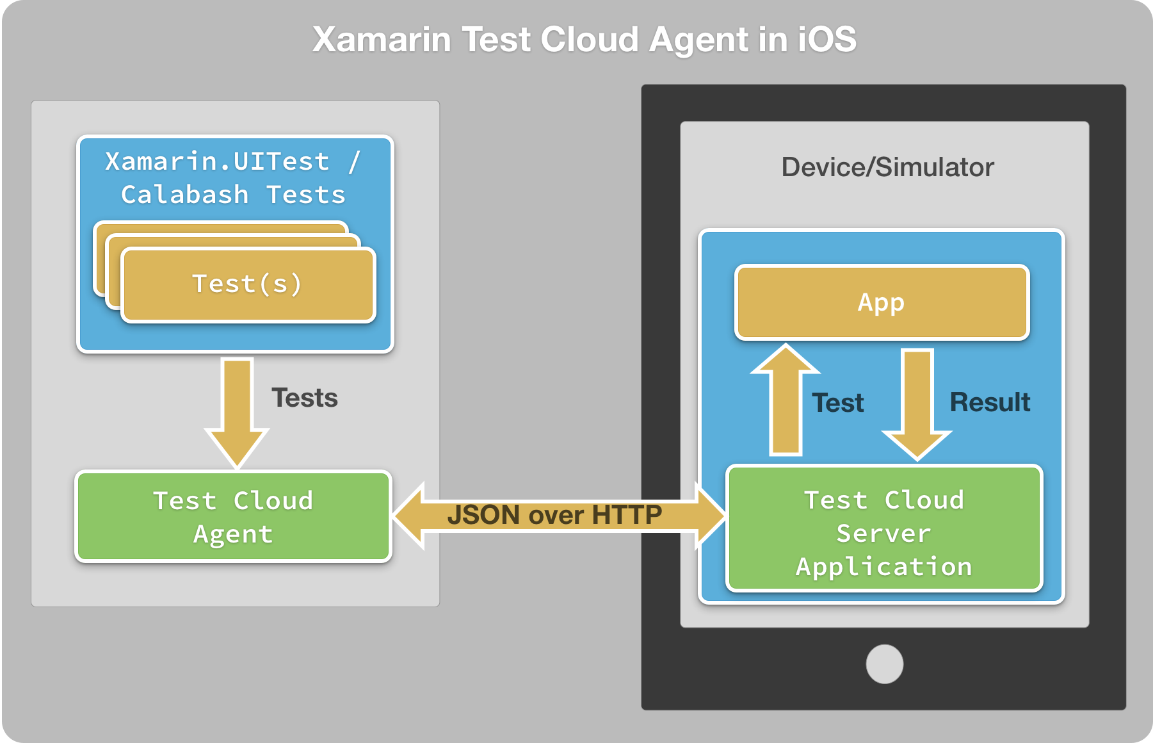
Xamarin.Process.Test – UITest 04
Architecture.iOS

Slide 15
Xamarin.UITest

Slide 16
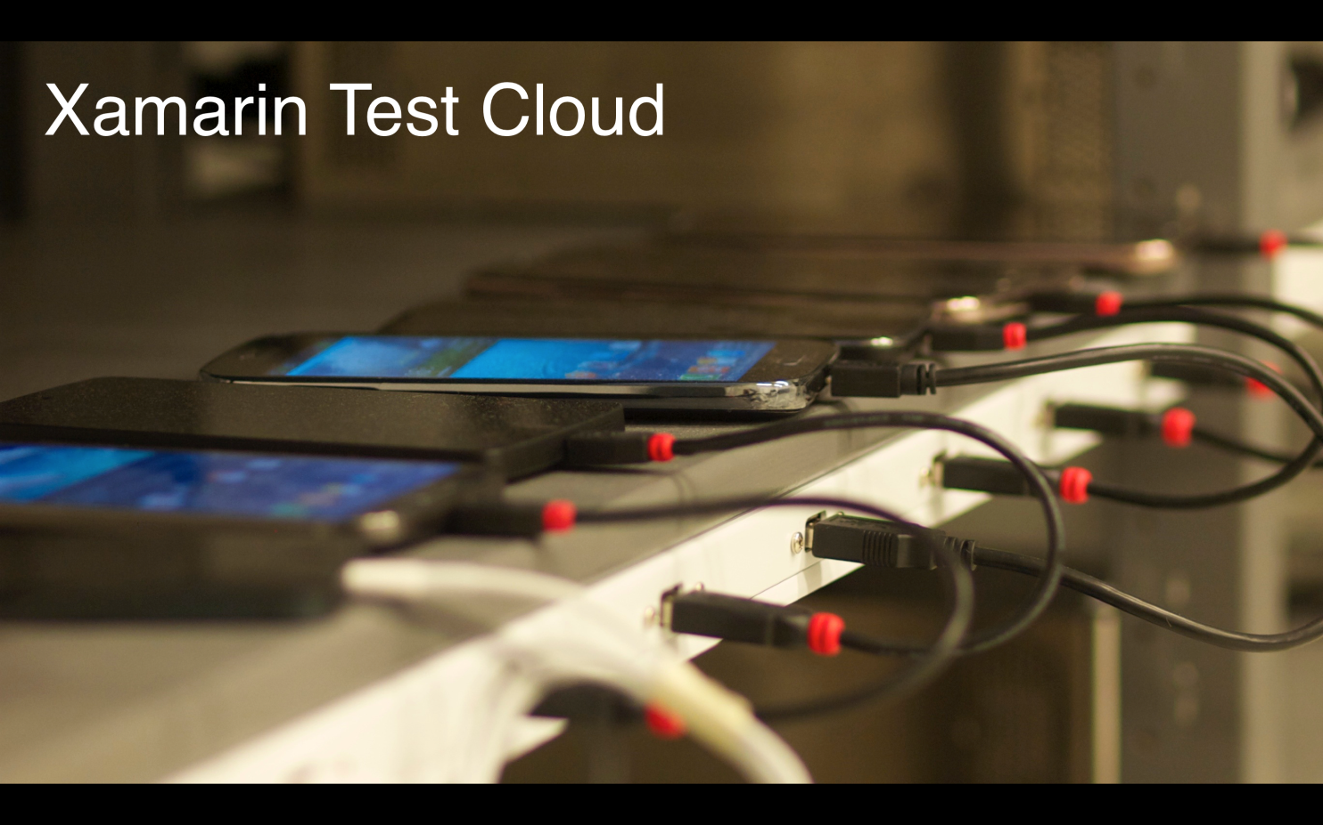
Xamarin.Process.Test – Test.Cloud 01
Xamarin.Test.Cloud
Cloud Service for UI Testing
Runs
Xamarin.UITests and
Calabash Tests
https://xamarin.com/test-cloud
https://testcloud.xamarin.com/

Slide 17
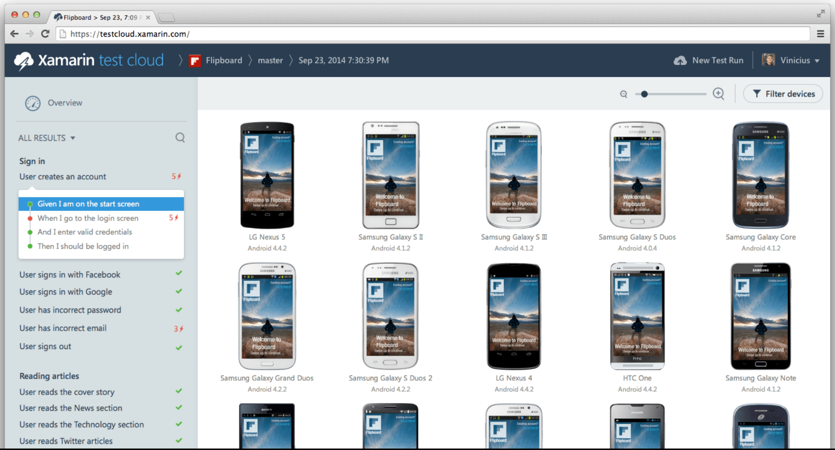
Xamarin.Process.Test – Test.Cloud 02
1800+ Devices (real devices) 2015-09-22
Android
iOS

Slide 19
Popunite ankete i osvojite vrijedne nagrade!
Ankete su dostupne na:
Mobilnim uređajima (Android, Apple, Windows)
Web-u http://www.mobilityday.com
PIN za pristup se nalazi na poleđini akreditacije i u vašem on-line profilu.

Slide 20
Xamarin.Process.Test – Test.Cloud 01
Architecture.iOS

